Slide 1

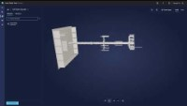
BUILD AGILE PLANNING AND DISTRIBUTION PROCESSES
Ensure business continuity
Leverage Digital Twins
Enhanced Efficiency and Productivity by optimize their operations, streamline processes, and reduce costs.
Improved Decision-Making by simulating various scenarios and test potential changes before implementing them in the physical system.
Increased Innovation and Agility with experiments without disrupting the physical system.
Azure Digital Twins

